Slide 1
Project Portfolio
Ethan Storer

Slide 2
Ethan Storer
Senior Mechanical Engineering Student, CS Minor
Valparaiso University, IN
1509 Chapel Drive
Valparaiso, IN
(636) 795-4392
ethan.storer01@gmail.com
www.linkedin.com/in/ethanstorer
To the FormFactor Hiring team,
With this portfolio, I am excited to showcase my growth and dedication as a designer and programmer over the past few years. This gallery depicts personally significant projects which reflect the honing of my skills. It is my intention that these showcased projects will reveal my passion for design and programming.
Sincerely,
Ethan Storer
SpinLaunch Hiring Team
SpinLaunch
4350 E Conant St,
Long Beach, CA 90808

Slide 3
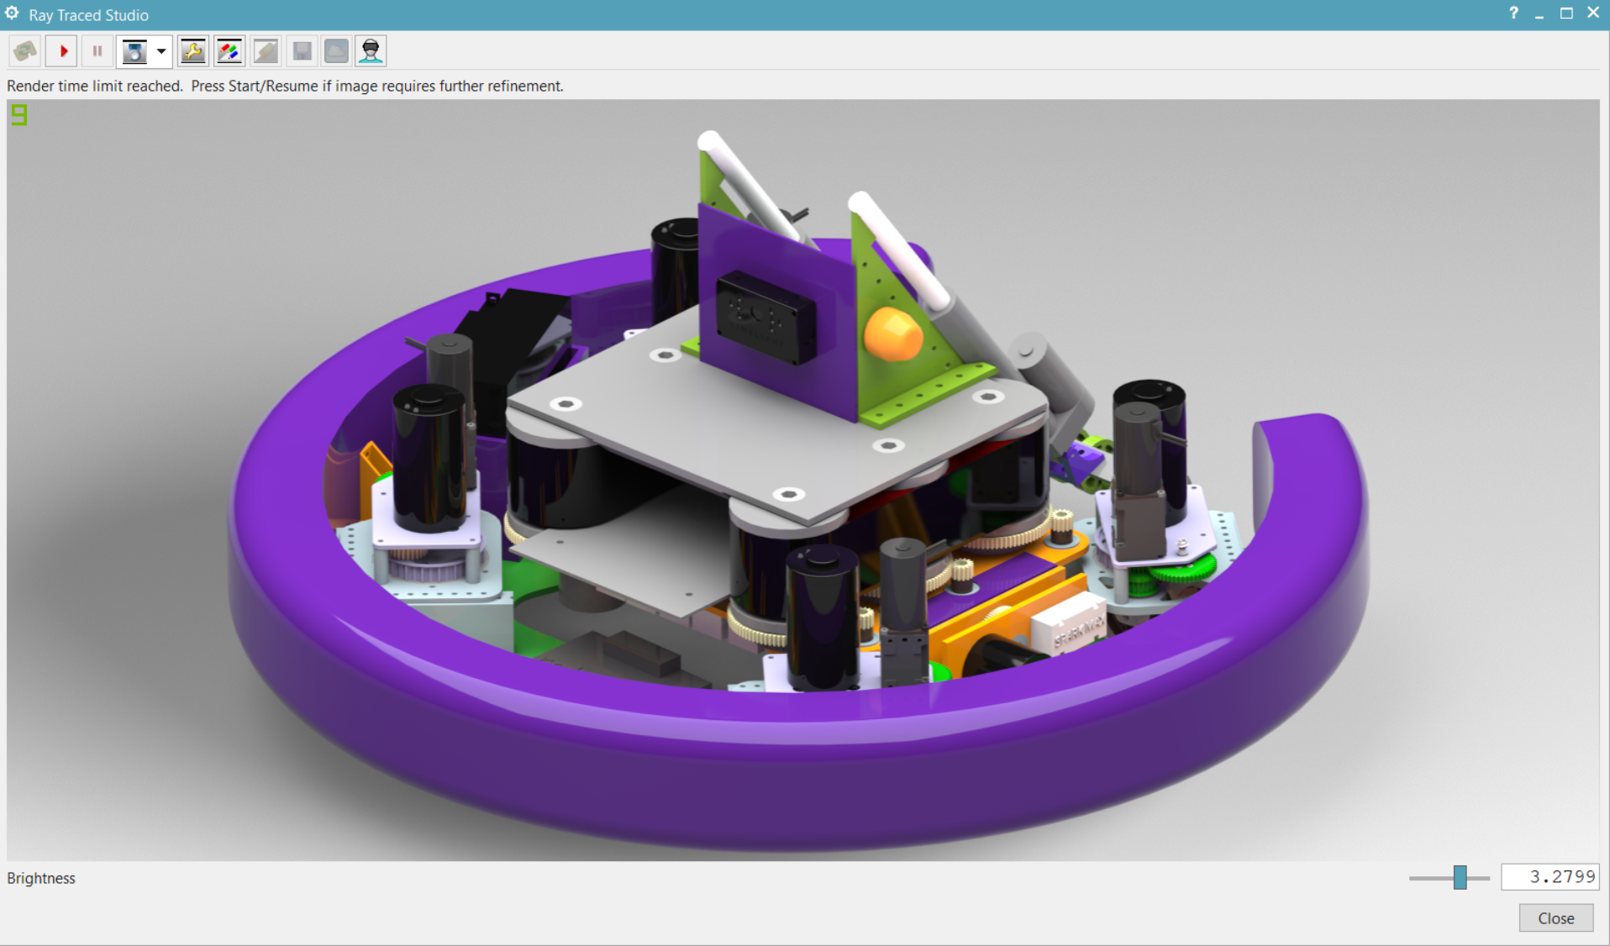
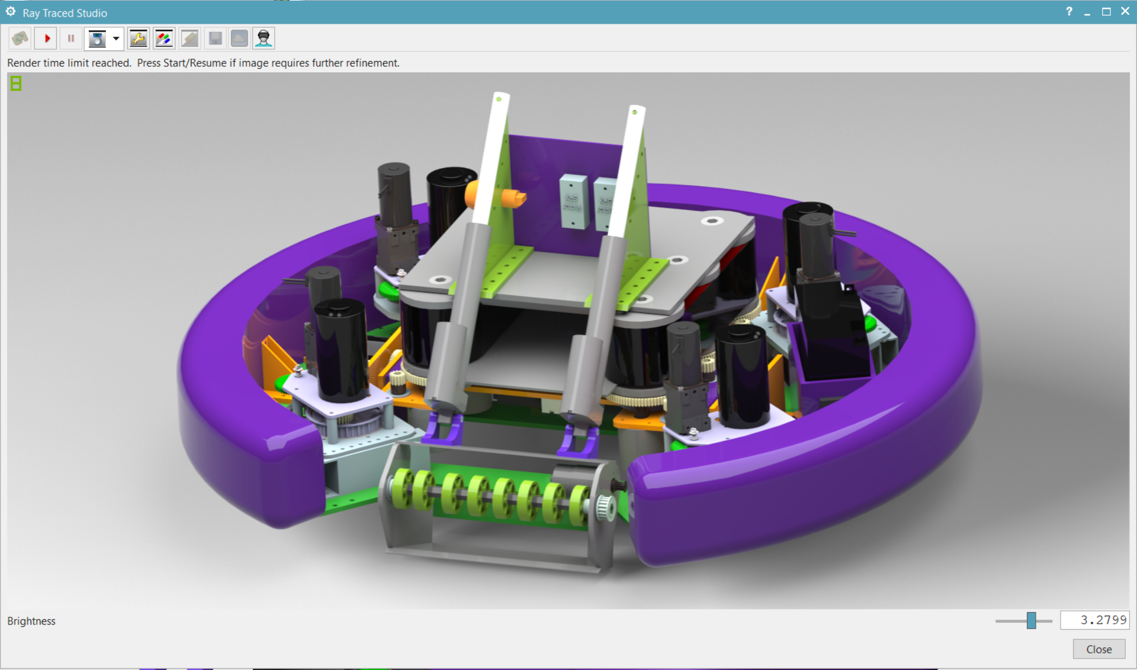
8th F4 CADathon, Dec 2019
The Puck Chucker was submitted for the 8th F4 CADathon competition in collaboration with an overseas student who I mentored throughout the process. The robot was planned and designed in approximately twelve hours with Siemens NX. According to mechanical calculations, this robot can launch an eight-inch hockey puck at 90 mph.

Slide 4
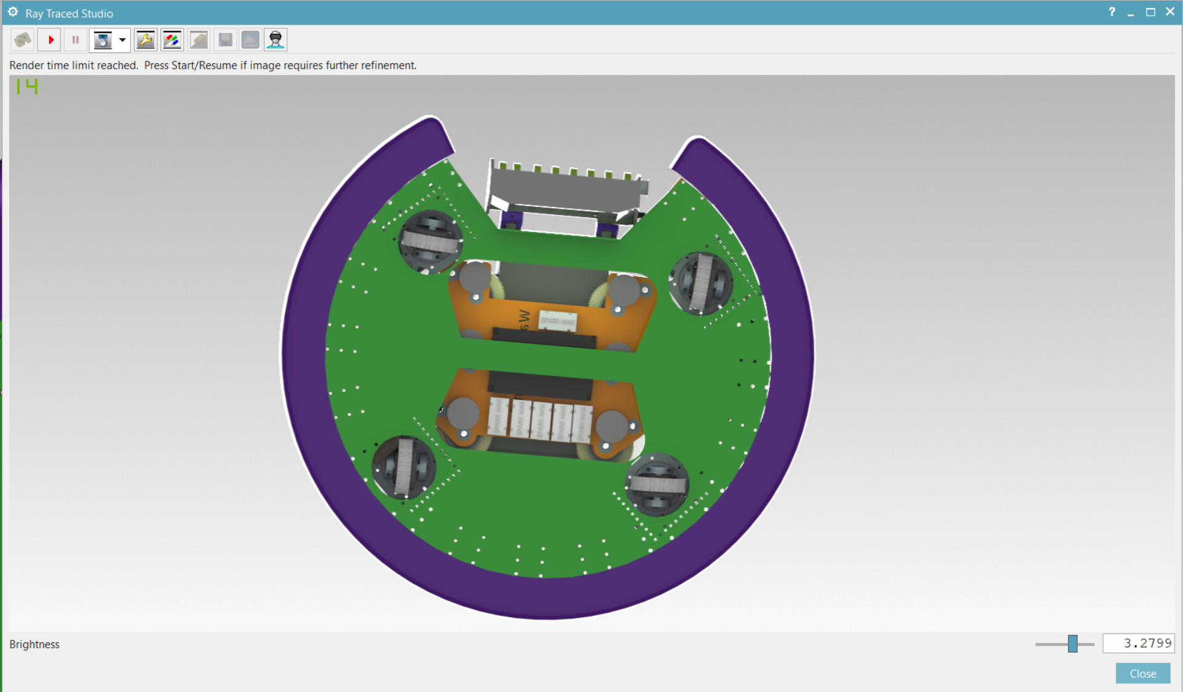
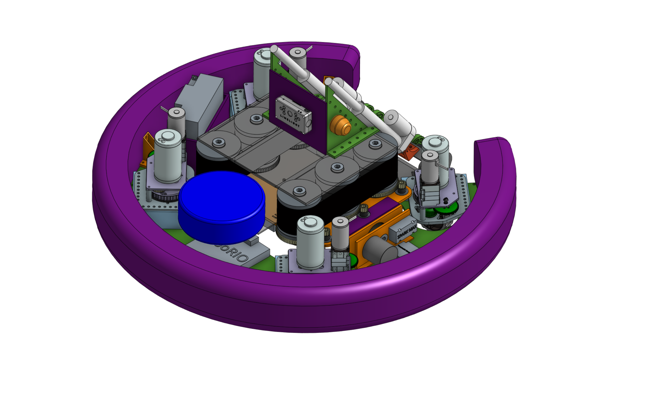
8th F4 CADathon, Dec 2019
Bottom Render and Isometric View of the Puck Chucker

Slide 5
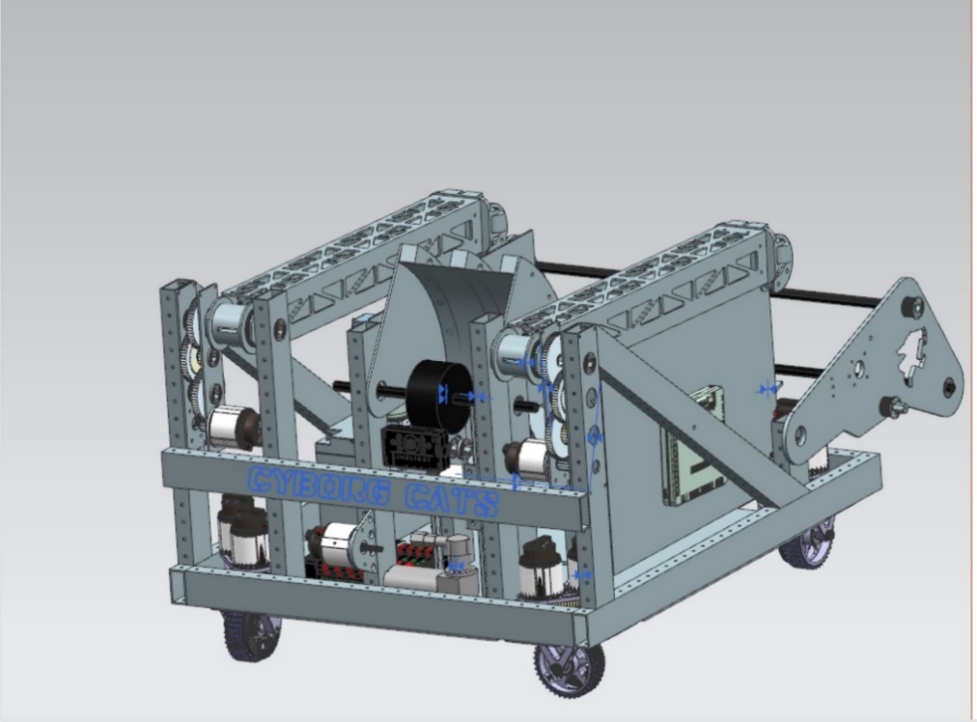
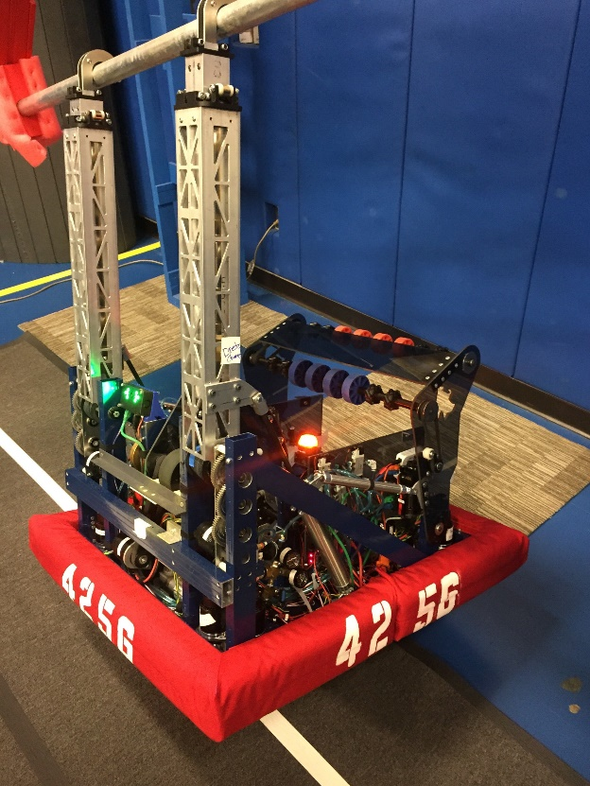
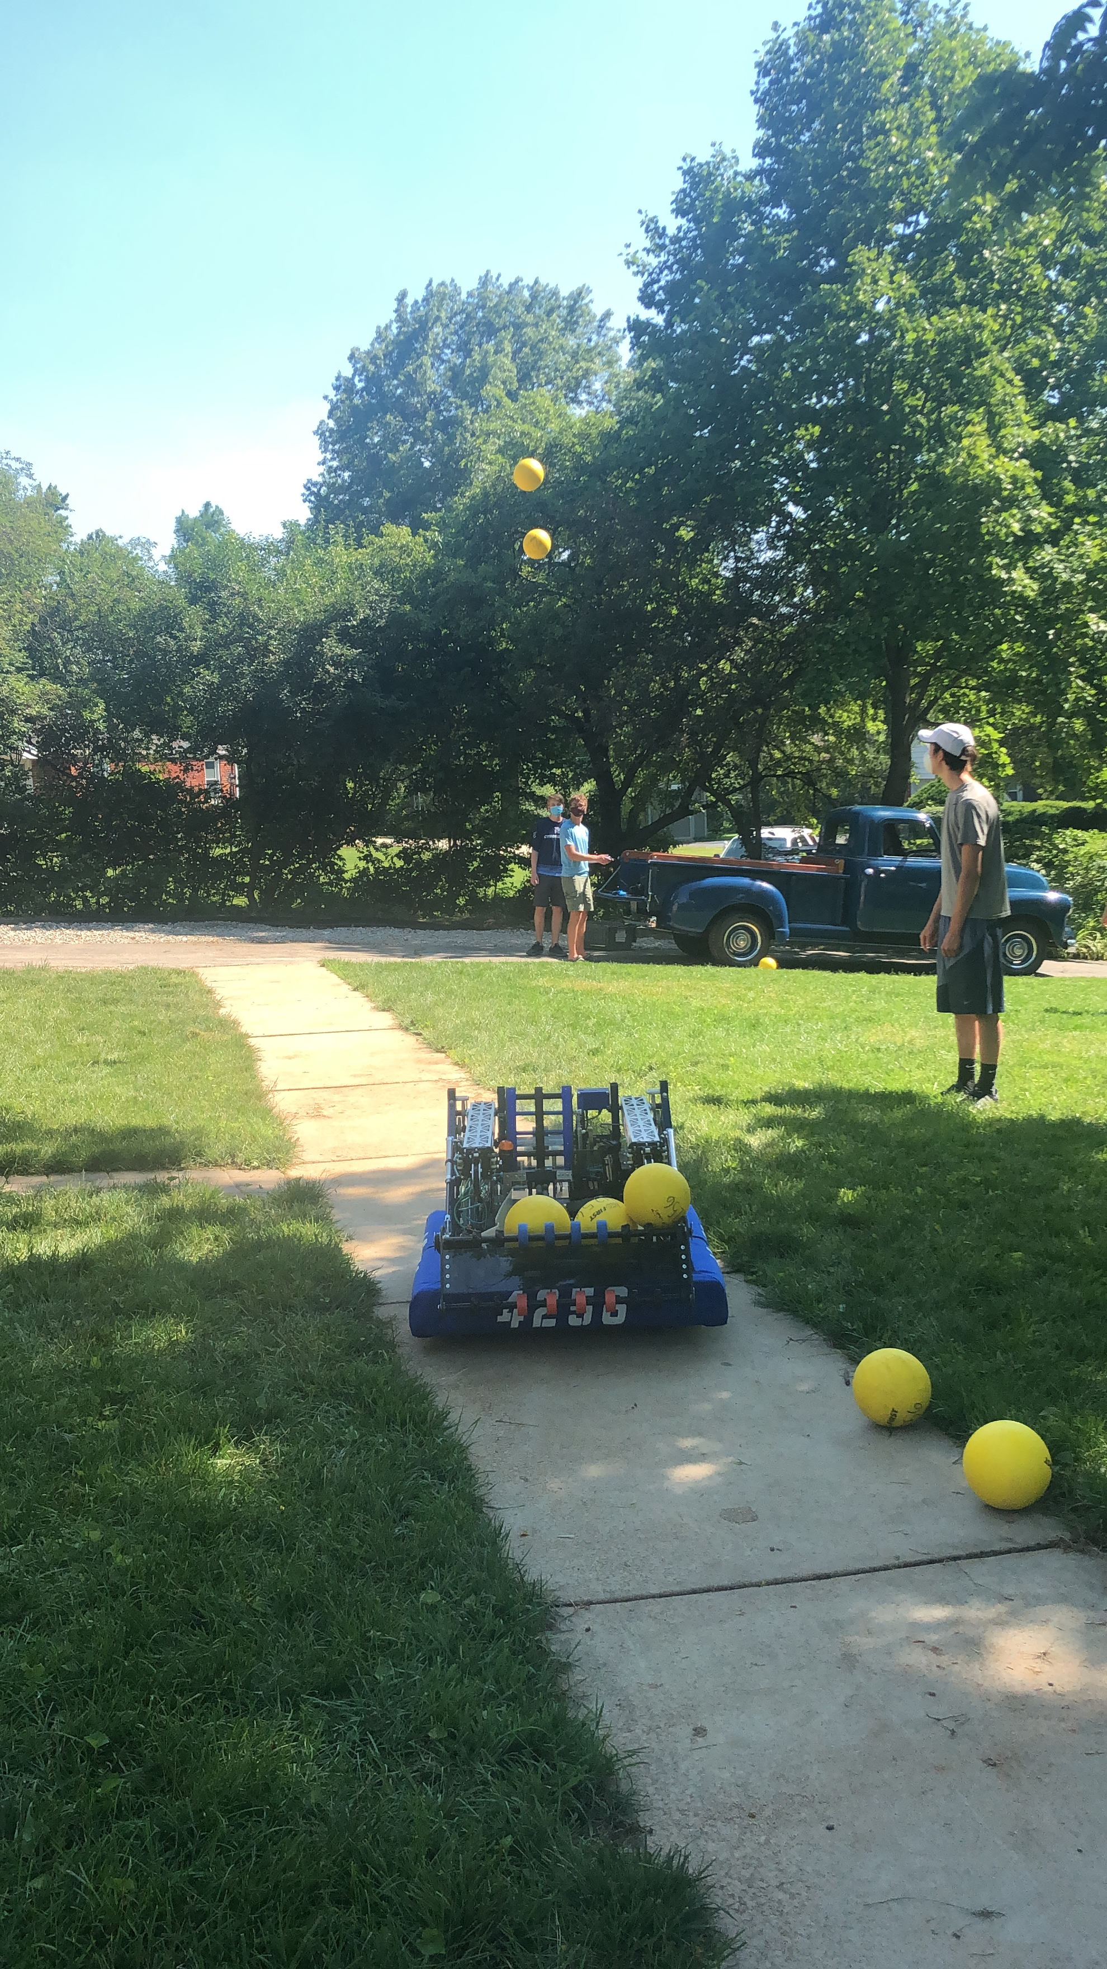
2020 FIRST Robotics Season: INFINITE RECHARGE
Robot CAD Model
Climbing arms pull the robot off the ground
Intake-Launcher System Demonstration
The 2020 build season gave me excellent design experience. In just eight weeks, I had designed this robot based on competitive strategy, oversaw prototyping, fabrication, integration, budgeted time for deadlines, and managed other students throughout the entire process.

Slide 6

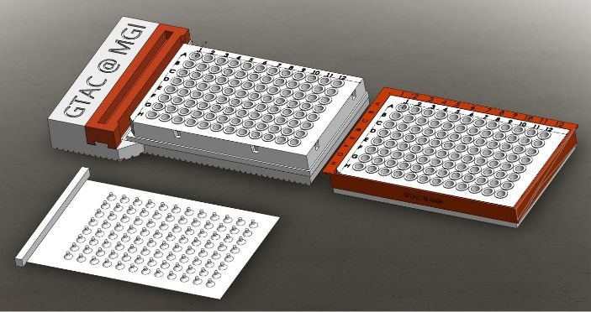
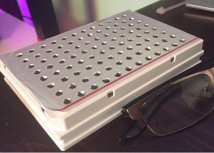
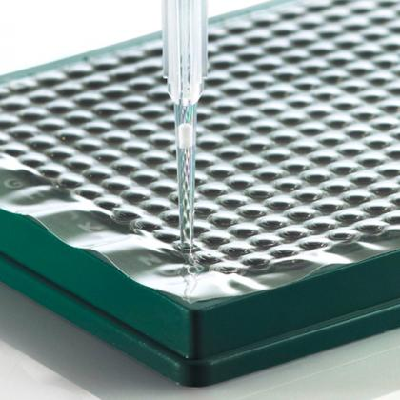
Custom Lab Development for GTAC@MGI, 2020
1
2
3
Pipette retrieving fluid from a well
Modular Foil Piercing System: Base (1), Skirt (2), and Piercer (3)
96-well plate with holes
Working with feedback from Washington University Lab technicians, I designed a Disposable Foil Piercer to rapidly punch holes in a 96-well plate with low cross-contamination risk of COVID-19 in rapid PCR tests.

Slide 7
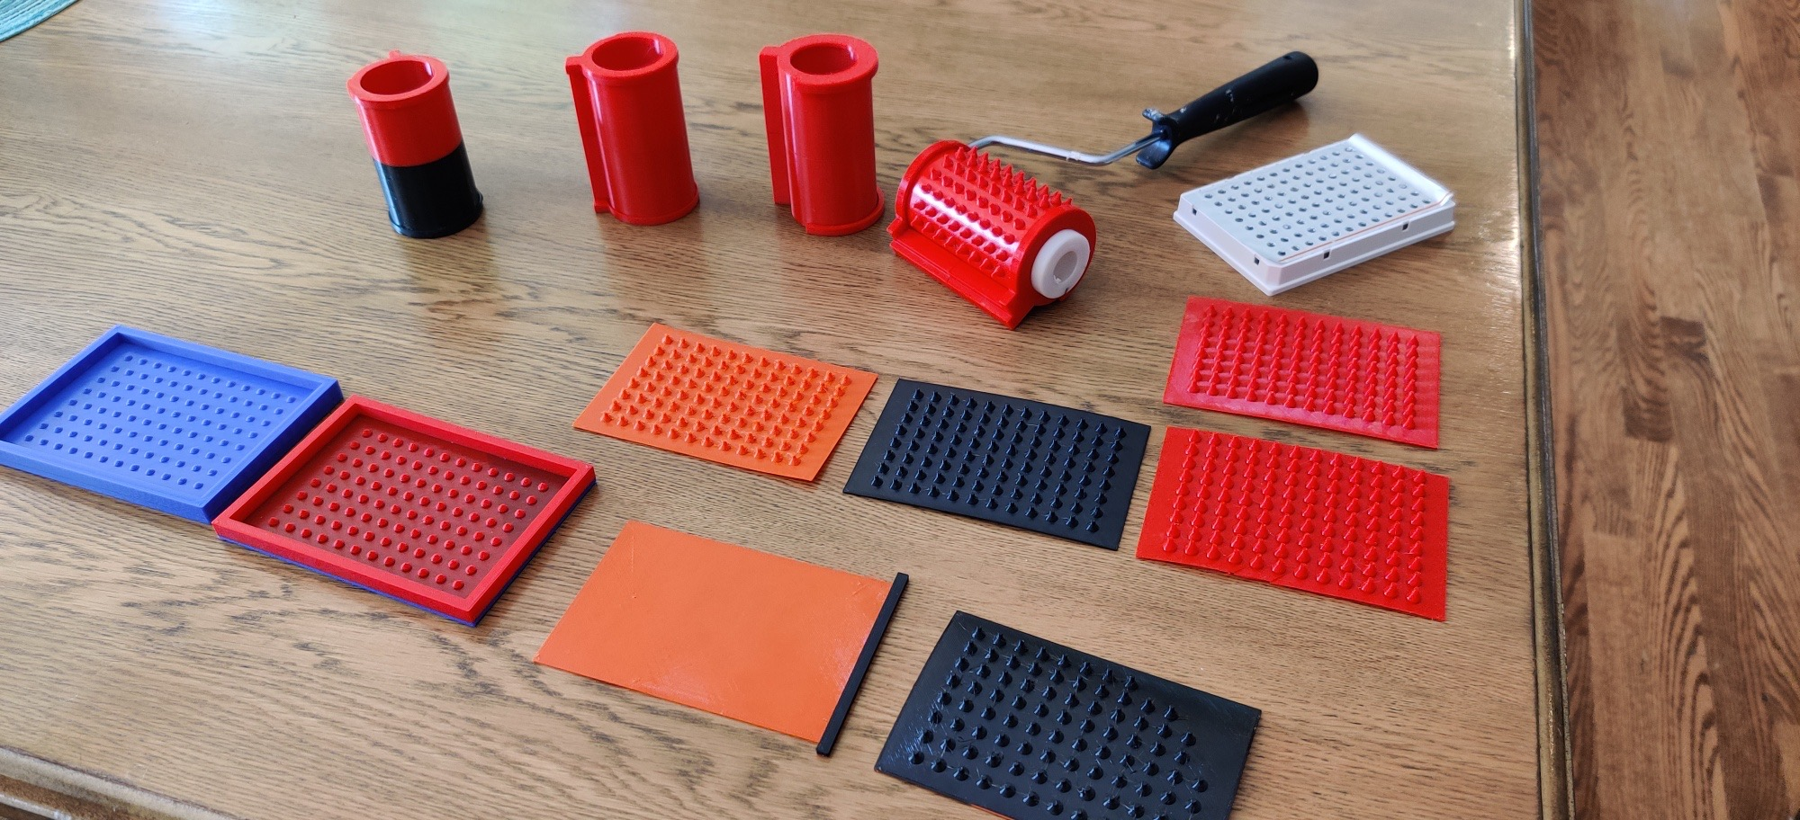
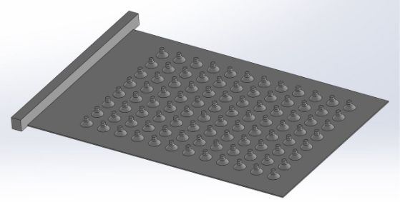
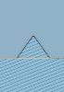
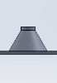
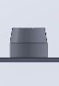
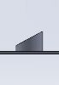
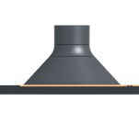
Custom Lab Development for GTAC@MGI, 2020
Foil Piercer Iterations, progression is roughly left to right, top to bottom
Final design of the Foil Piercer
Foil Piercer geometries, final geometry on right
With 3D printing, I rapidly prototyped different foil piercer shapes and ideas.

Slide 8
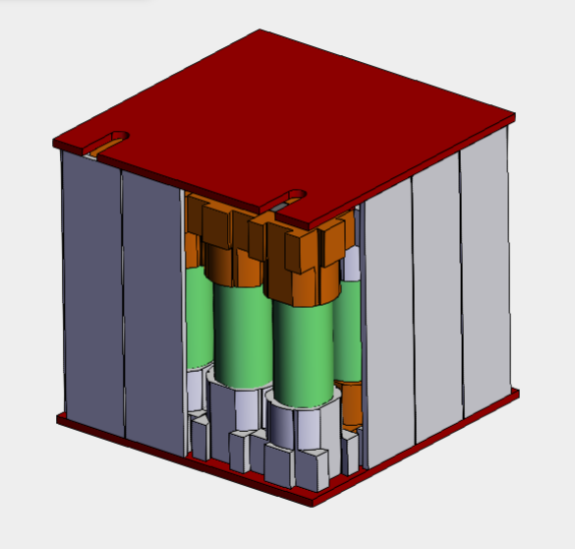
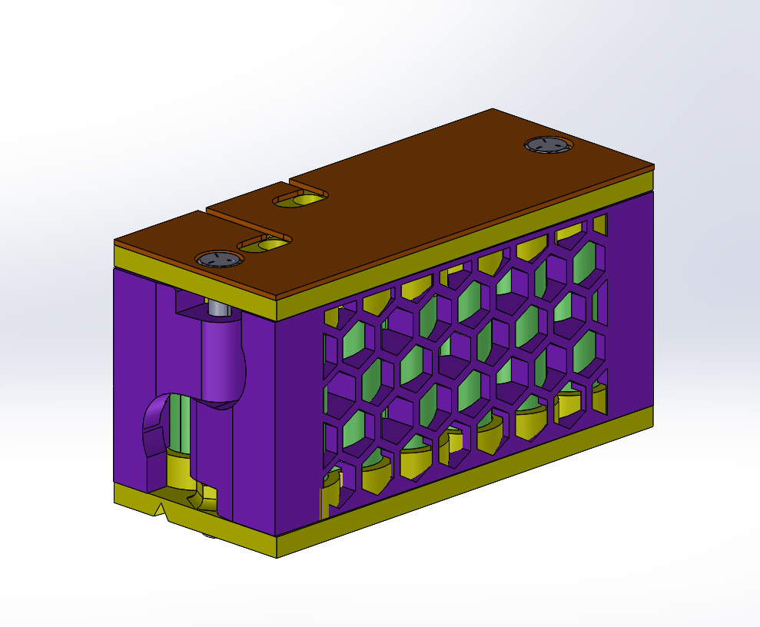
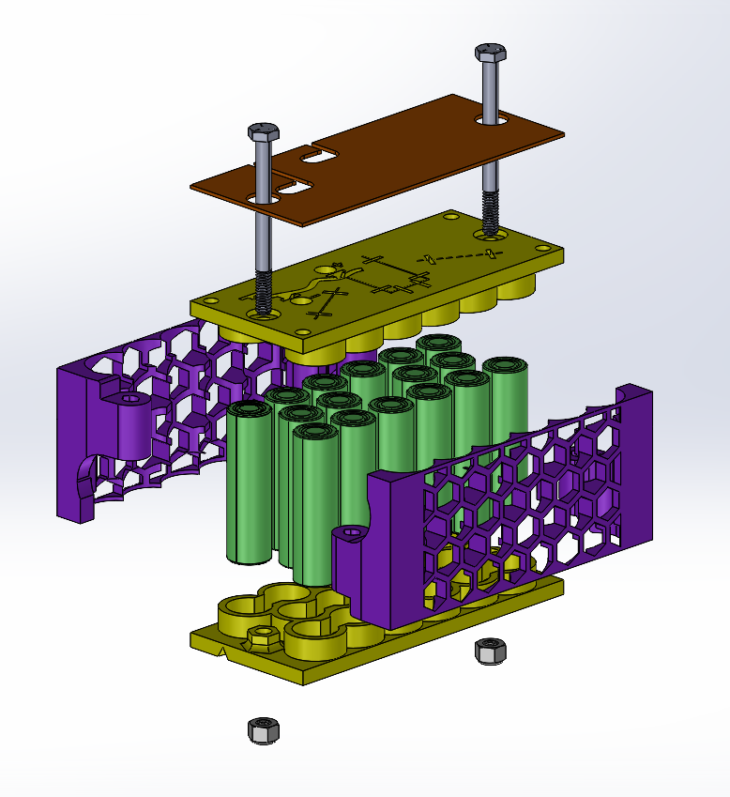
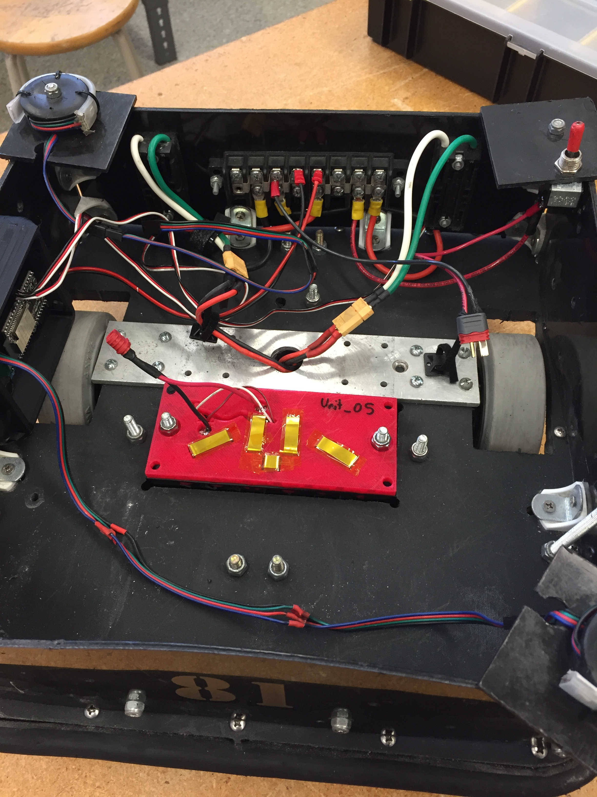
Lithium-Ion Battery Pack for Quarterback, 2021
Simple Cube Prototype: Isometric View
Hot-Swap Prototype: Isometric View
Exploded View: wiring slots visible on upper yellow piece
Lead acid battery replaced with my Hot-Swap Prototype in a Lineman robot
I designed this 3D-printed Lithium-ion battery pack to power the Quarterback for our robot football team. It runs at 12 volts with a capacity of 6 amp-hours. The final prototype is designed to match the geometry of existing lead-acid batteries and hot-swap with them.

Slide 9
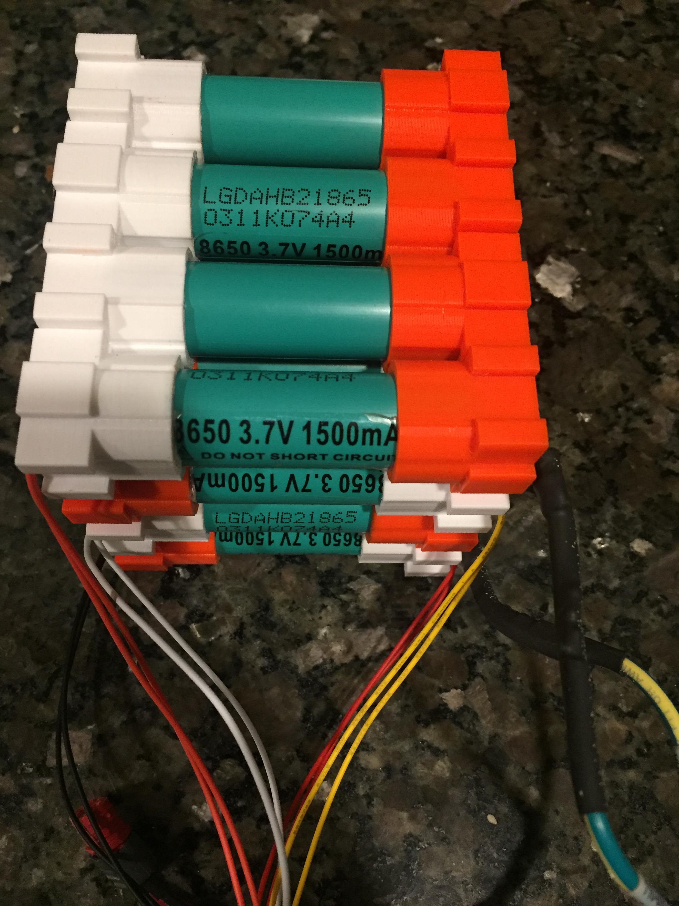
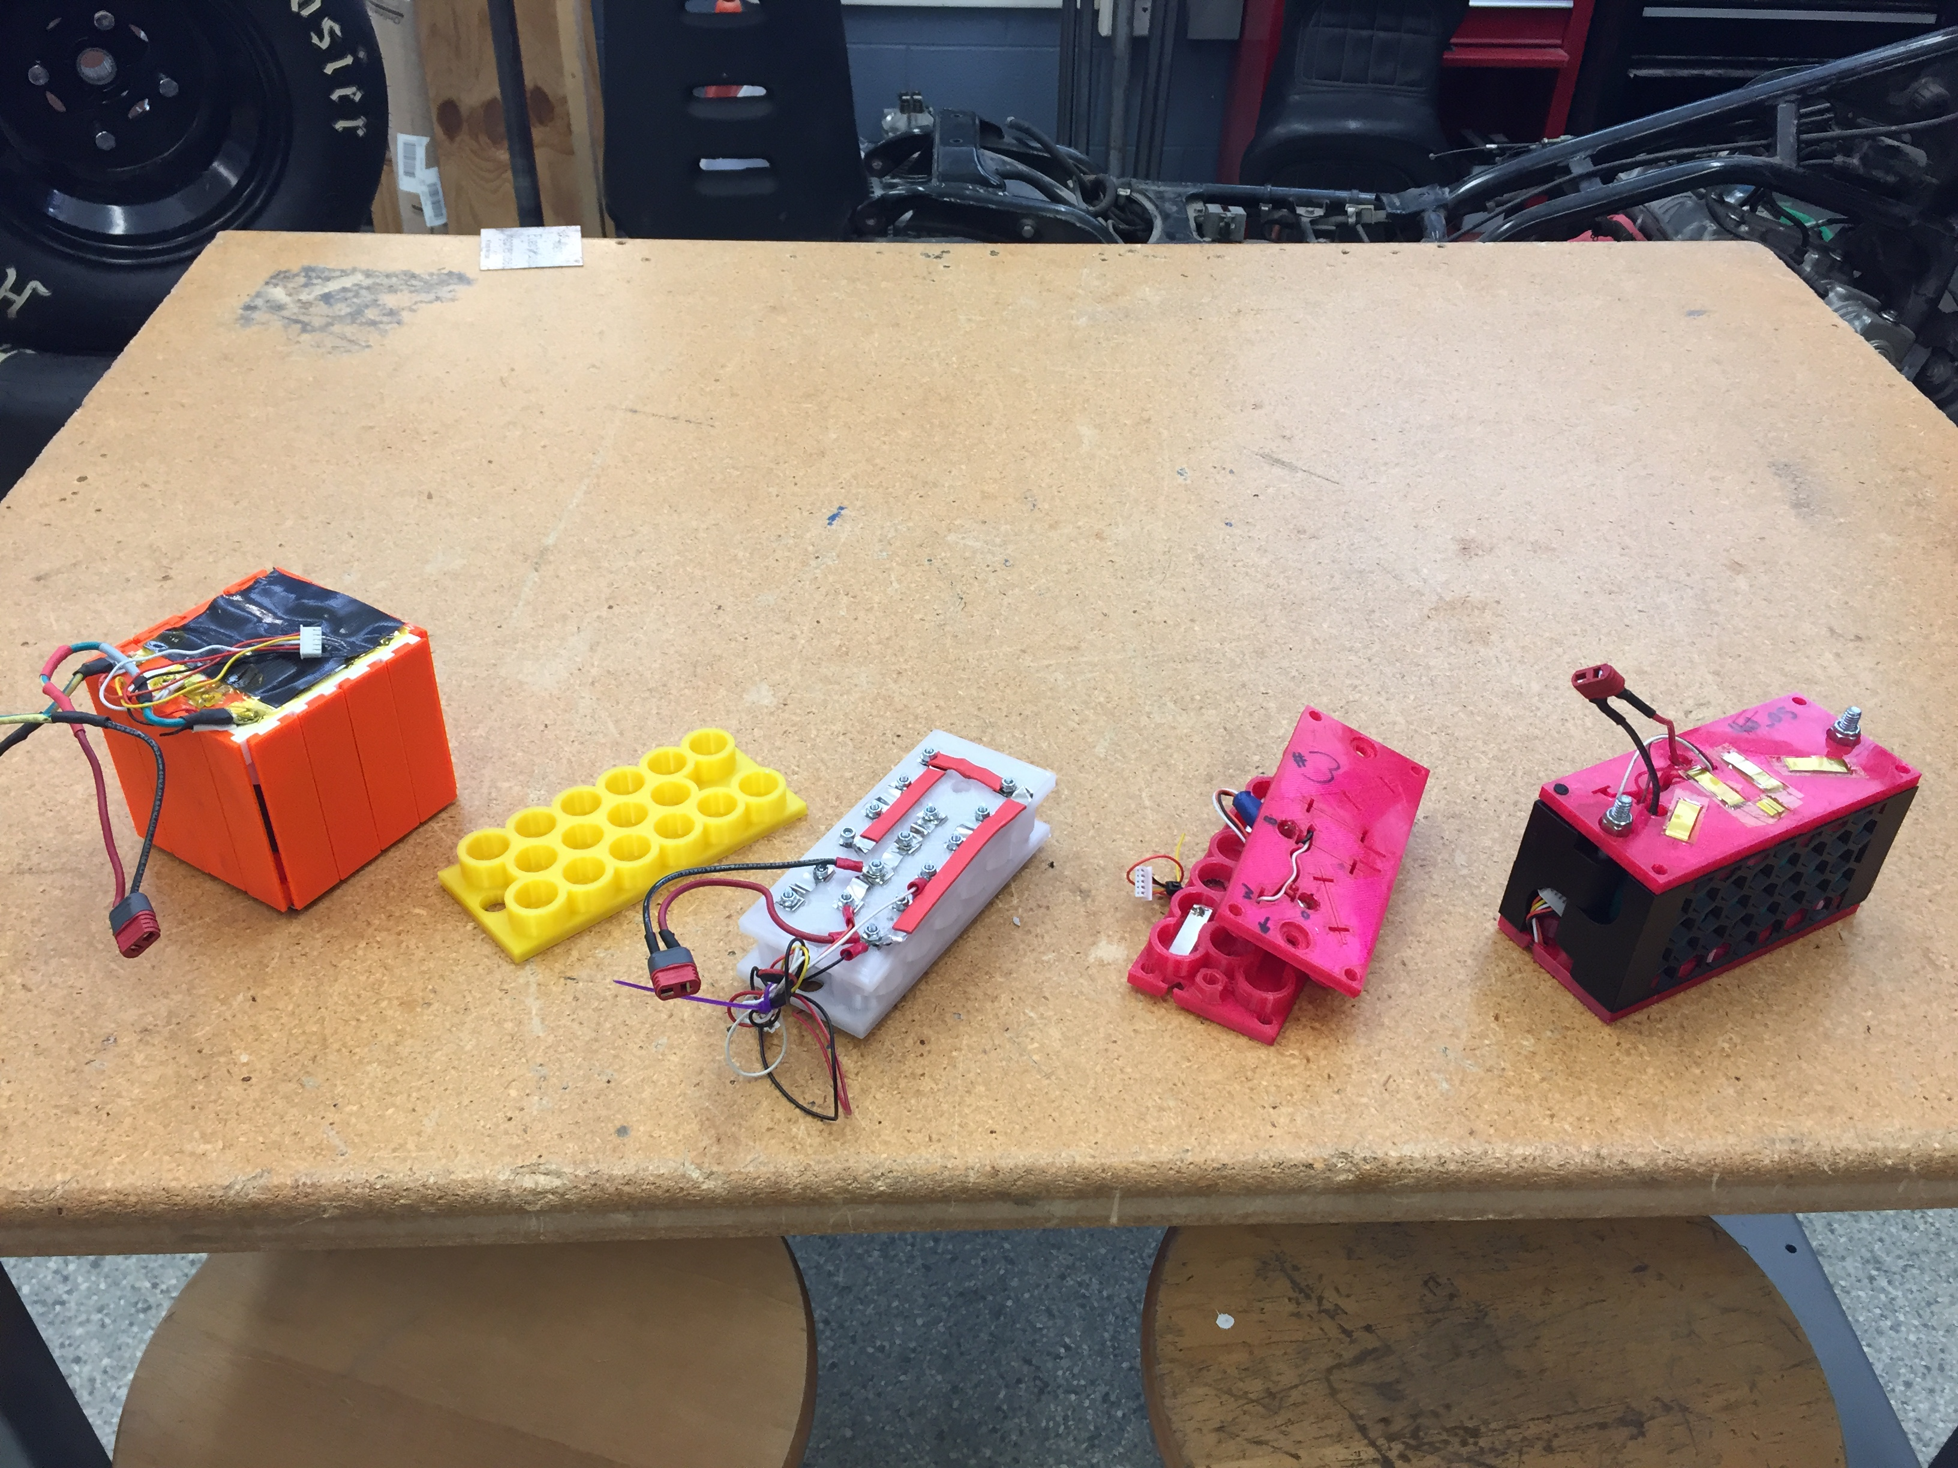
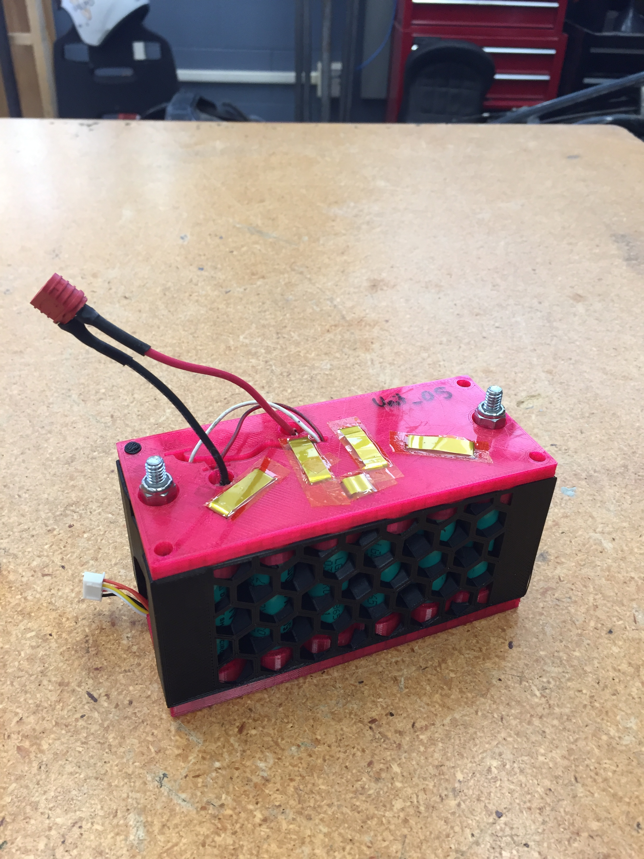
Lithium-Ion Battery Pack for Quarterback, 2021
Simple Cube Prototype Pack
Initial, intermediate, and final design iterations
Hot-Swap Prototype
The design was iterated from a block with simple and direct wire pathing to a rectangular shape with a more compact and sophisticated wire pathing. Over 10 total 3D printing iterations were needed to ensure tolerance and correct geometry.

Slide 10
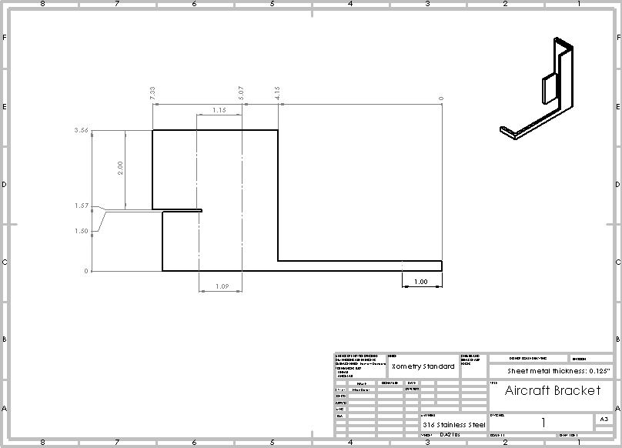
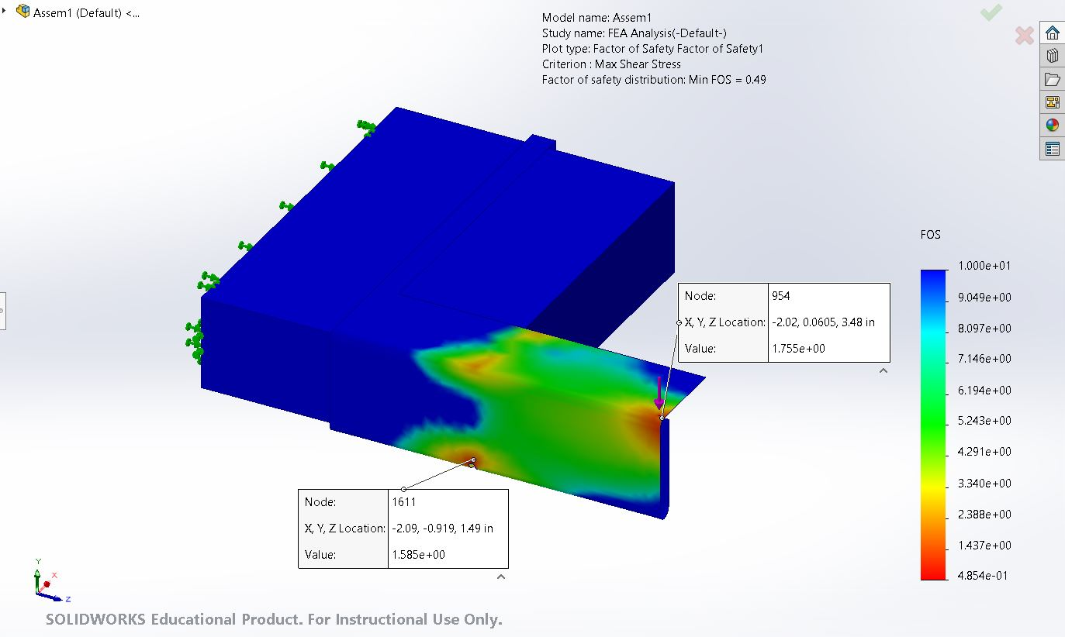
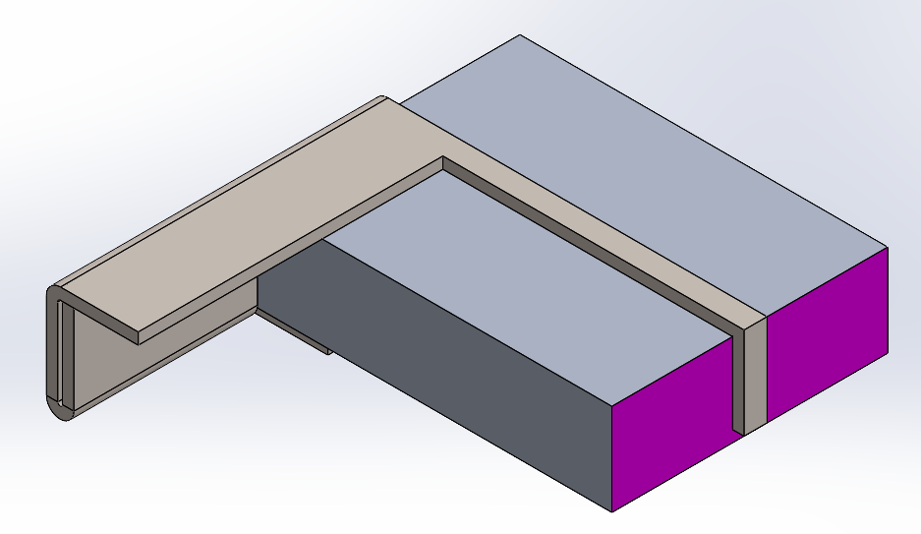
Aircraft-Standard Bracket for FEA Class Project Fall, 2022
Storer.pdf
This stainless-steel sheet metal bracket is designed to support 500 lbf, have a minimum 1.58 factor of safety, and be easily manufactured. I used the design and FEA packages in SOLIDWORKS to model the bracket’s shape, material, and performance.

Slide 11




GitHub Repository for Coding Projects, Fall 2023
Storer.pdf
https://github.com/ethan-storer

